Slide 1

Research Data Documentation: Codebooks, Data Dictionaries & ReadMe Files

Slide 2
Documentation - what is it?
Documentation is information you note about your data and research
Documentation may make note of:
Data variable meanings
File organization structures
Methodologies employed
Context of your data and research
Project contributors

Slide 3
Why should you spend time on documentation?

Slide 4
Documentation in Plain Text

Slide 5
Why use plain text files?
Plain text file formats are universally accessible across machines and across time

Slide 6
Could you open a file saved by this machine?

Slide 7
How do you create plain text files?
Text editors
Mac: TextEdit
Windows: Microsoft Notepad
Sublime, Brackets, etc.
Exportation from proprietary software
Word: save file as .txt
Excel: save file as .csv

Slide 8
Types of Documentation
ReadMe Files, Data Dictionaries, & Codebooks

Slide 9
Types of research documentation
ReadMe Files
Data Dictionaries
Codebooks
Describe local files and folders
Describe data in spreadsheets or databases
Describe survey design, variable meanings, and coded data

Slide 10
ReadMe Files
What information do the files in this folder contain?

Slide 11
ReadMe files
Content described | Files and folders in working directories
Where to create them | Working directories (i.e. active working folders)
Use | Navigation Instructions for using files
Format | Plain text files

Slide 12
Information to include in a ReadMe file
Project Level ReadMe
File/subfolder Level ReadMe
Organization of a directory
Context of your project/directory
Software & OS used
People involved and contact info
Purpose of file/folder
Interdependencies of files in a folder
How and why files were created

Slide 13
ReadMe file example

Slide 14
Data Dictionaries
What does that column header mean?

Slide 15
Data Dictionaries
Content described | Spreadsheets
Where to create them | Working directories (near the spreadsheets they describe)
Use | Interpretation of data fields Database management
Format | Spreadsheet

Slide 16
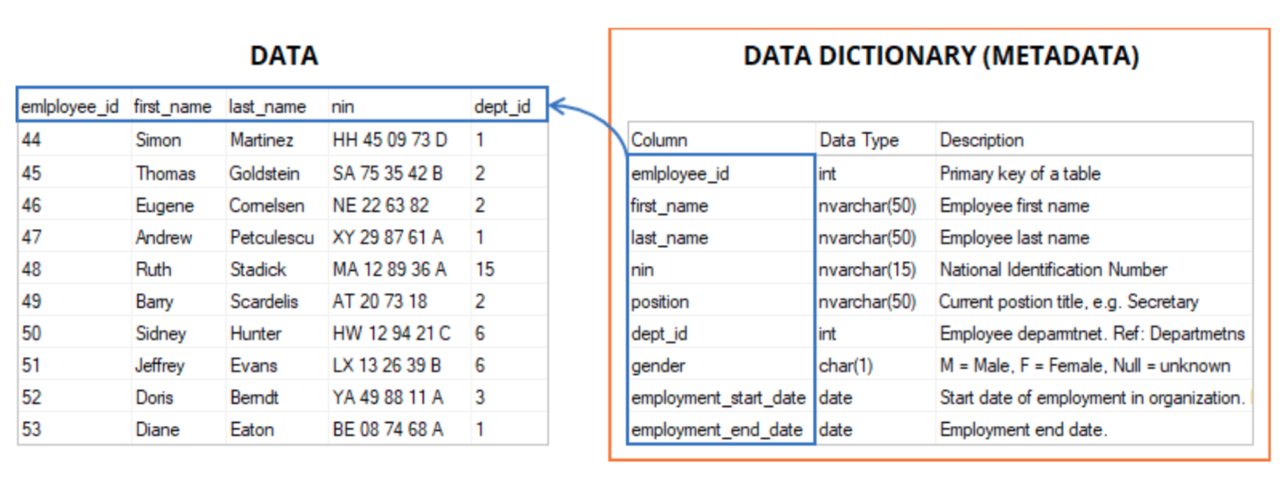
Data dictionary example

Slide 17
Data dictionary fields
Field | Data type | Field format | Length | Description | Nulls
date | date | YYYY-MM-DD | 10 | Date of exam | Not null
gender | char | m, f, n | 1 | Patient’s gender m = male f = female n = nonbinary | Null value indicates information not collected
mrn | int | X-XXXX | 6 | Medical record number (MRN) to serve a a patient’s uid | Not null

Slide 18
Codebooks
What does this survey response mean?

Slide 19
Codebooks
Content described | Research projects, data collection instruments and collected data
Where to create them | Data repositories
Use | Interpretation of data fields and variables Interpretation of data collection proceedures
Format | PDFs (when downloaded)

Slide 20
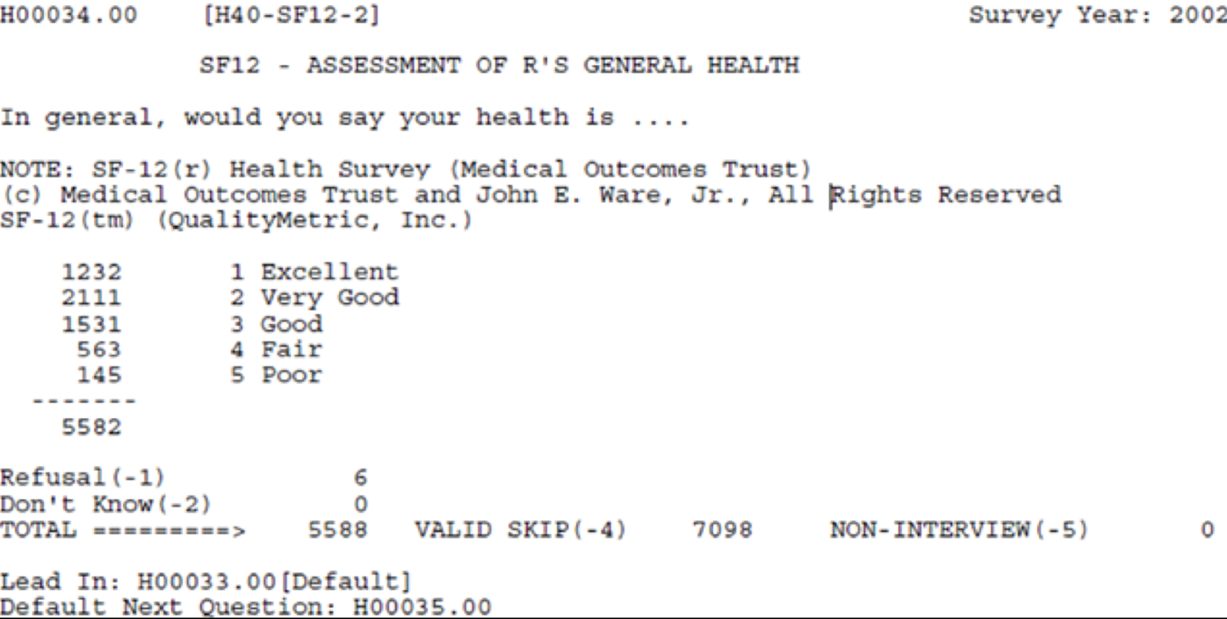
Codebook example

Slide 21
Information to include within a Codebook
Variable names
Question text
Summary statistics
Missing data
Notes

Slide 22
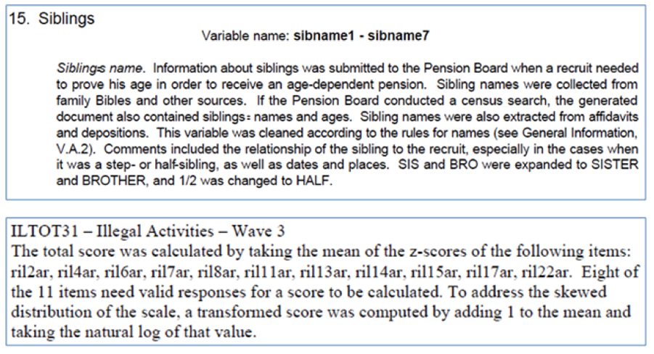
Variable names

Slide 23
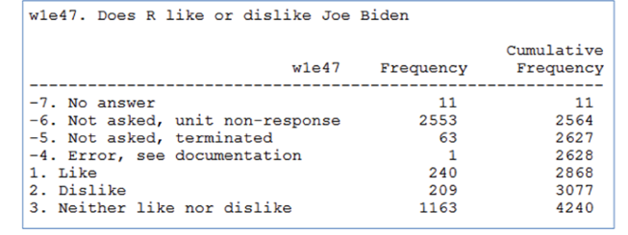
Summary statistics

Slide 24
Wrap up
Where should you look for additional information and tools on documentation?

Slide 25
Tools for documentation creation
DDI’s Create a Codebook
https://ddialliance.org/training/getting-started-new-content/create-a-codebook
Best Practices for Research Data Management
https://library.medicine.yale.edu/research-data/best-practices
Cornell Guide to Writing a ReadMe file for research data
https://data.research.cornell.edu/content/readme

Slide 26

Data Documentation Initiative (DDI)
DDI is an international standard for describing research data
ddialliance.org

Slide 27
Contact medicaldata@yale.edu
?
?
?

